Slide 1

Government polytechnic for women kadapa Approved by AICTE, New Delhi &Affiliated to SBET ATP
COMPUTECHIE
Half yearly Magzine
July-December 2023
Department of
Computer Engineering
Volume - 2 issue- 1

Slide 2
Department Vision
Develop computer engineers to be technologically adept, innovative, self-motivated, responsible citizen with human values, high quality skill and to contribute significantly towards ever changing computer technologies.
Department Mission
M1: To provide opportunity to Diploma students who are capable of playing pivotal role in wide aspects of modern computer engineering.
M2: To make the students understand basic concepts underlie in computer engineering and able to apply them creatively in different fields of engineering.
M3: To train the students sensitive to the environment ,safety and economic context.
M4: To produce technically skilled students through intensive training in computer engineering tools and applications and to prepare the for professional career and further research.
GOVERNMENT POLYTECHNIC FOR WOMEN, KADAPA

Slide 3
About Department
The Department of Computer Engineering was established in the year 2008, offering “Diploma in Computer Engg” with intake 50, affiliated to SBTET, AP, Mangalagiri. The Diploma in Computer Engg Programme has a comprehensive curriculum on topics related to all aspects of Computer Hardware and Software with an emphasis on practical learning. The course structure is up-to-date and includes courses on nascent topics to equip our students with the latest developments in Computer Science and Engineering.
It has consistently fulfilled its role of producing Computer Engineers ready to meet the demands of the IT world. The department has always attracted the best of engineering girl aspirants from all over the Rayalaseema Region of Andhra Pradesh
GOVERNMENT POLYTECHNIC FOR WOMEN, KADAPA

Slide 4
Program Educational Outcomes
PEO1
To produce best diploma students as computer engineering technicians by correlating growing need of the industries in modern topics with the academic input and giving the technical knowledge for further learning and to provide better career in this field.
PEO2
To prepare the students as productive computer engineer s , possessing , supportive and leadership skills in multi disciplinary domain expertise in practical orientation , communication skills and latest developments.
PEO3
To give the depth of related skills and expertise in a single field and the ability to collaborate with other disciplines and work at the supervisory cadre.
GOVERNMENT POLYTECHNIC FOR WOMEN, KADAPA

Slide 5
PEO4
To promote the students in professionalism, by successful completion of the Diploma in Computer Engineering by empasizing field practice in industry oriented activities.
PEO5
To sensitize the students on social and economic commitment and to inculcate a nature to gaurd the values of community and protect environment
GOVERNMENT POLYTECHNIC FOR WOMEN, KADAPA

Slide 6
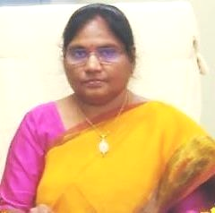
MESSAGE
PRINCIPAL’s MESSAGE
Smt . C.H.JYOTHI,
M .Tech
It gives me immense pleasure to pen a few words as prologue to the half yearly technical magazine COMPUTECHIE exclusively meant for churning out the latent writing talent which bears immense potentially of sharpening the students skills as part of their overall personality development .I congratulate all the contributors for bringing out such a beautiful magazine.
GOVERNMENT POLYTECHNIC FOR WOMEN, KADAPA

Slide 7
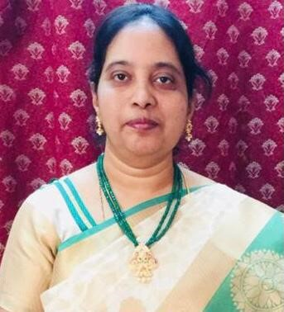
HOD’s MESSAGE
Smt.K. SUDHARANI M.tech
It is a occasion of great pride and satisfaction for the department of CME, GPW to bring out the issue of the half yearly of the Technical magazine COMPUTECHIE. It gives me immense pleasure to note that the response to the magazine has been overwhelming .The wide spectrum of articles gives us a sense of pride that our students and faculty possess creative potential and original thinking in ample measures. Each article is entertaining interesting and absorbing .I applaud the contributors for their stimulated thoughts and varied hues in articles contributed by them.
GOVERNMENT POLYTECHNIC FOR WOMEN, KADAPA

Slide 8

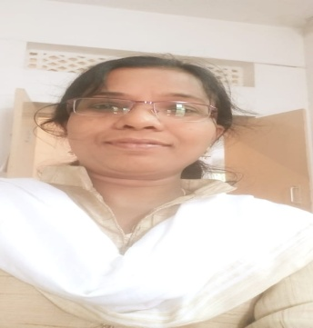


EDITORIAL TEAM
Smt. B .Leela Padmavathi , L/DCME
Kum . M. Prameelamma, L/DCME
K. Sunanda ,DCME,II year
A. Baby Sravanthi , DCME,II year
GOVERNMENT POLYTECHNIC FOR WOMEN, KADAPA

Slide 9
FACULTY ARTICLES
HUMAN COMPUTER INTERACTION
Human-Computer Interaction (HCI) is the study and practice of designing, implementing, and evaluating user interfaces between humans and computers. It focuses on ensuring that computer systems are usable, efficient, and enjoyable for users to interact with.
HCI considers the entire user experience, encompassing not only the graphical user interface (GUI) but also the underlying technology and how it is integrated into people's lives. It takes into account the cognitive, emotional, social, and physical aspects of human interaction with computers.
The goal of HCI is to facilitate effective and efficient use of computer systems, enhance user satisfaction and productivity, and improve overall user experience. It aims to bridge the gap between human behavior and computer capabilities, ultimately making technology more accessible, user-friendly, and personalized to individual needs.
HCI draws upon various disciplines such as psychology, cognitive science, design, ergonomics, and computer science to inform the design process. It emphasizes user-centered design principles, involving users in the design process through user research, user testing, and iterative prototyping.
Key concepts in HCI include:
1. Usability: The extent to which a system is easy to use and learn. It focuses on factors like learnability, efficiency, memorability, error prevention, and user satisfaction.
2. User Experience (UX): The overall experience and perception of a user when interacting with a system. It involves elements such as aesthetics, emotions, pleasure, engagement, and satisfaction.
3. Interaction Design: The process of defining the behavior, appearance, and layout of a computer system's user interface. It considers principles like affordance, feedback, consistency, and simplicity to create intuitive and effective user interactions.
4. Accessibility: Ensuring that computer systems are usable by individuals with disabilities or impairments. It involves considerations for users with visual, hearing, motor, and cognitive limitations.

Slide 10
Virtual Reality
Virtual reality refers to the use of computer technology to create a simulated environment that can be experienced by an individual through sensory stimuli, such as visual, auditory, and haptic feedback. It involves wearing a special device, such as a headset or goggles, that tracks the user's movements and provides a three-dimensional immersive experience. By presenting a digital alternate reality, virtual reality can transport users to different places, times, or situations that may be fictional or based on real-life scenarios. It can be used for various purposes, including entertainment, gaming, education, training, therapy, and even research. Virtual reality has the potential to create highly realistic and interactive experiences that can engage multiple senses and provide a sense of presence in a virtual world.
GOVERNMENT POLYTECHNIC FOR WOMEN, KADAPA

Slide 11
Student article 5G wireless technology
5G wireless technology refers to the fifth generation of wireless communication technology. It is designed to provide faster data speeds, lower latency, increased capacity, and more reliable connections compared to previous generations. Here are some key characteristics of 5G technology:
1. Faster Speeds: 5G is capable of delivering significantly faster download and upload speeds compared to 4G. It can theoretically reach up to 10 gigabits per second (Gbps), allowing for quick streaming, downloading, and uploading of large files.
2. Low Latency: Latency refers to the time it takes for data to travel from the source to the destination. 5G aims to reduce latency to less than 1 millisecond, which is crucial for real-time applications like gaming, autonomous driving, and remote surgeries.
3. Increased Capacity: 5G uses wider bandwidths and more advanced antenna technologies to support an increased number of connected devices simultaneously. This is particularly important in densely populated areas where the demand for network capacity is high.
4. Improved Reliability: With 5G, connections are expected to be more reliable and stable, minimizing disruptions and dropped calls. This is achieved through better signal quality, multiple input and multiple output (MIMO) antennas, and advanced network management techniques.
GOVERNMENT POLYTECHNIC FOR WOMEN, KADAPA

Slide 12
MACHINE LEARNING
Machine learning is a subset of artificial intelligence (AI) that focuses on giving computers the ability to learn and make decisions without explicit programming. It involves developing algorithms and models that enable computers to automatically learn and improve from experience, without being explicitly programmed for each specific task.
The core idea of machine learning is to build and train models using large amounts of data, teaching the computer to recognize patterns and make predictions or decisions based on that data. These models learn from the data by identifying patterns, relationships, and correlations, and then make predictions or take actions based on this learned knowledge.
There are different types of machine learning algorithms, such as supervised learning, unsupervised learning, and reinforcement learning. In supervised learning, the algorithm learns from labeled data, where the correct answer or output is known. It then uses this knowledge to predict the output for new, unseen data points. Unsupervised learning, on the other hand, involves finding hidden patterns or structures in unlabeled data, without any predefined outputs. Lastly, reinforcement learning focuses on training algorithms to make decisions in an environment, learning from feedback or rewards received for the actions taken.
Machine learning has a wide range of applications across various fields such as finance, healthcare, retail, manufacturing, and more. It has the capability to analyze large and complex datasets, identify trends, detect anomalies, make predictions, automate processes, improve efficiency, and enhance decision-making.
However, machine learning models can be challenging to build and require careful data preparation, feature engineering, and model tuning. It also requires extensive computational resources for training complex models. Additionally, ethical considerations, biases, and interpretability of the models are important factors to address when implementing machine learning solutions.

Slide 13
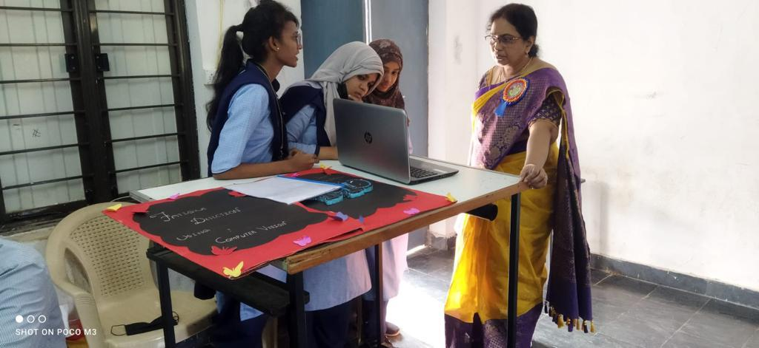
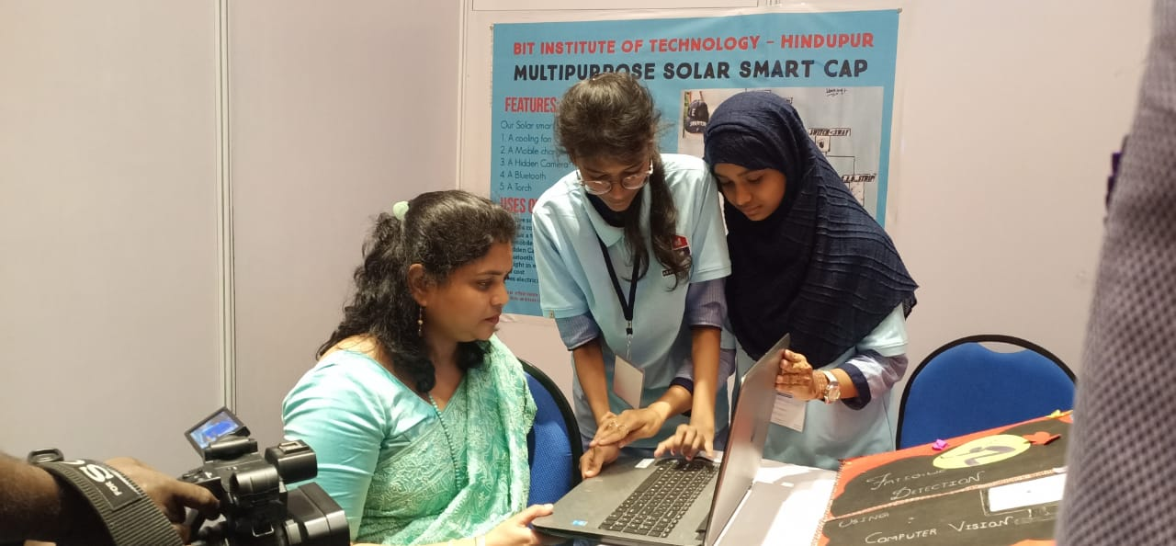
TECHFEST
Fatigue Detection using Computer Vision
by G. Hemamalini , K.G.Neetu shahee , S. Sana tasleem
GOVERNMENT POLYTECHNIC FOR WOMEN, KADAPA

Slide 14
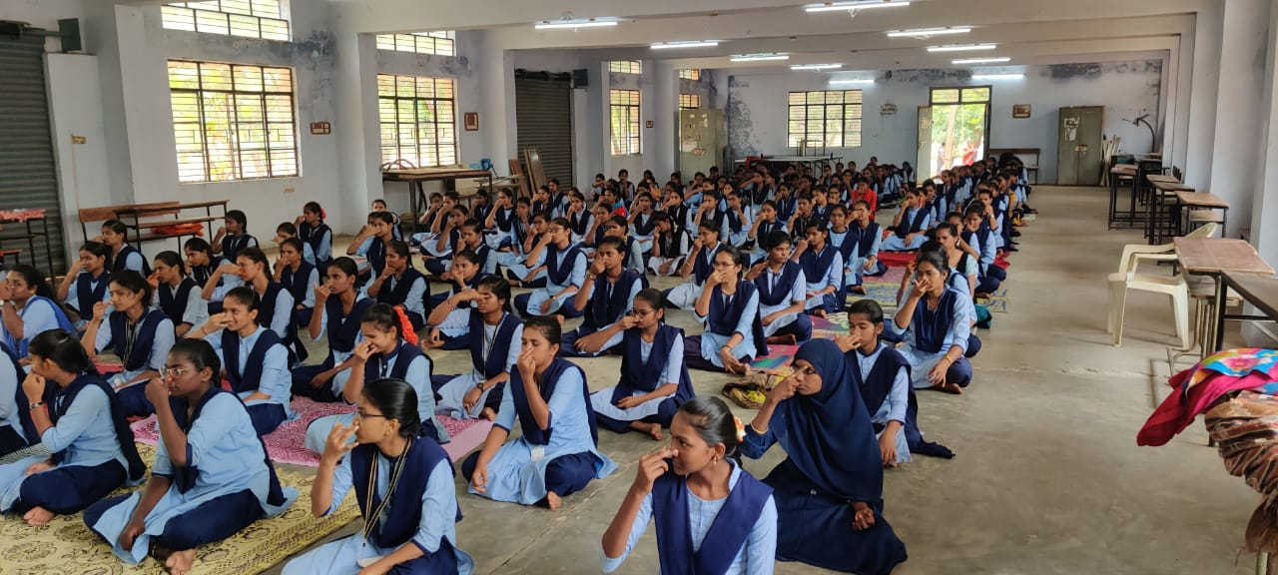
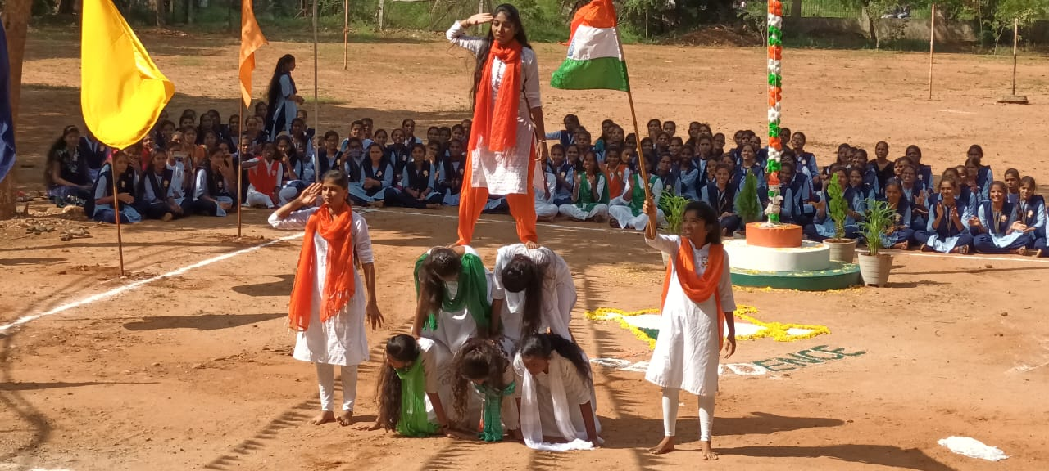
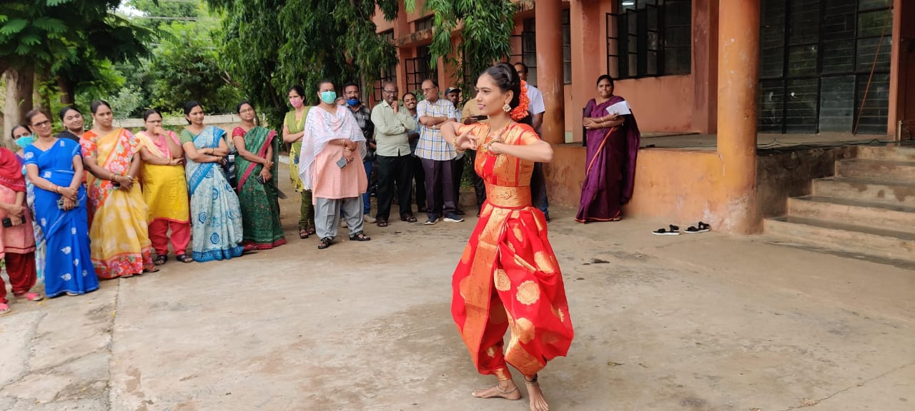
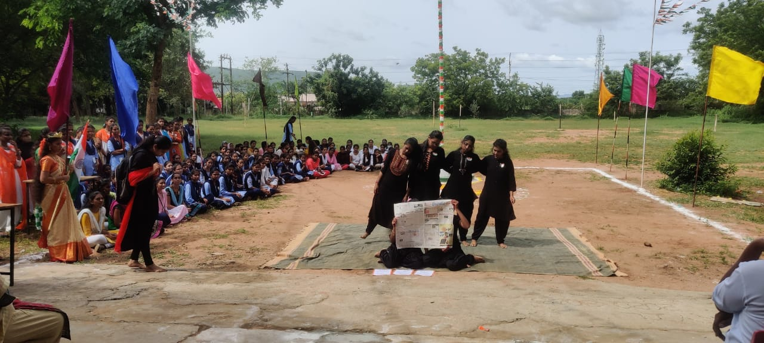
OTHER CURRICULAR ACTIVITIES
GOVERNMENT POLYTECHNIC FOR WOMEN, KADAPA

Slide 15
THANK YOU

